Slide 1


Stripe
Author: Phat.Tran
12/2024

Slide 2


TABLE OF CONTENTS
01.
04.
Overview
Demo
02.
05.
Why choose Stripe?
Q & A
03.
Comparing key features & pricing

Slide 3


Overview

Slide 4

Overview

Slide 5
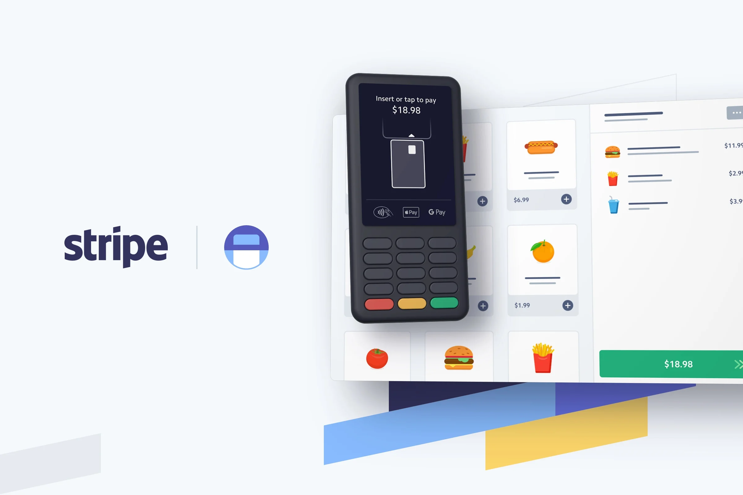
Overview
Stripe is a robust platform that simplifies online payment processing, enabling businesses to accept payments, manage subscriptions, and handle complex financial transactions with ease.
With features that support global scalability and security, Stripe is trusted by millions of companies worldwide

Slide 6
Why choose Stripe?

Slide 7
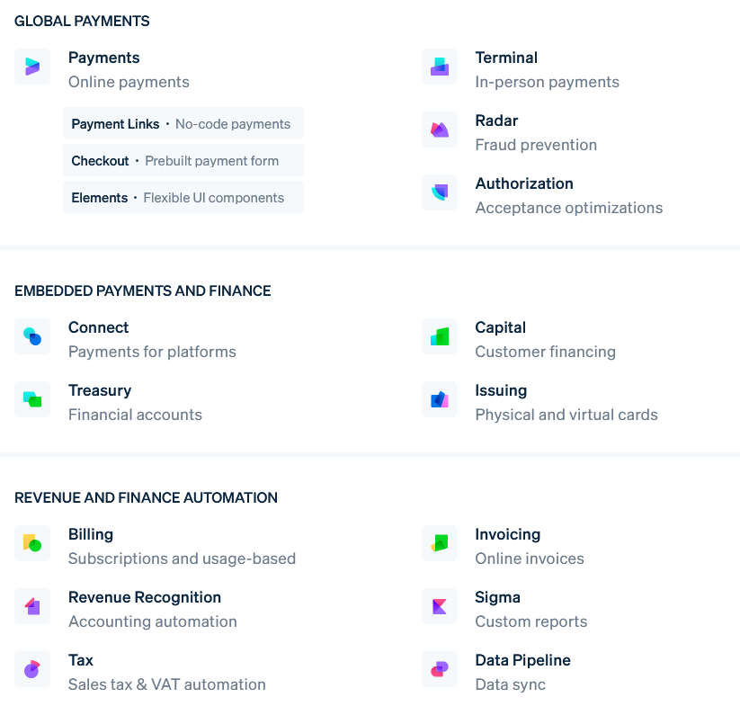
Why choose Stripe?
Comprehensive Features: It offers powerful tools for payment processing, subscription management, invoicing, and recurring billing, as well as for handling complex financial workflows. This all-in-one solution helps businesses manage their finances more efficiently

Slide 8
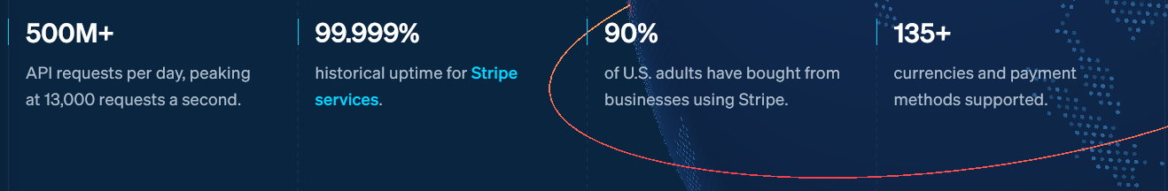
Why choose Stripe?
Global Reach, Reliable and Scalable: It supports payments in over 135 currencies and operates in more than 100 countries. It can automatically handle foreign currency conversions. This feature enables global business expansion and makes it convenient for businesses to accept international payments and receive payouts in their preferred currency

Slide 9
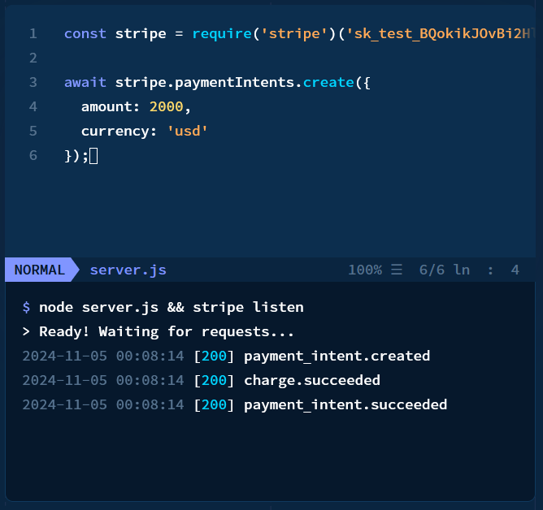
Why choose Stripe?
Easy Integration and Advanced Security: Stripe offers comprehensive documentation and libraries for various programming languages, enabling seamless integration with any technology stack. It complies with PCI DSS (Payment Card Industry Data Security Standard) to safeguard sensitive payment data, and Stripe Radar employs machine learning for effective fraud detection and prevention, enhancing security for businesses and customers across all channels.

Slide 10
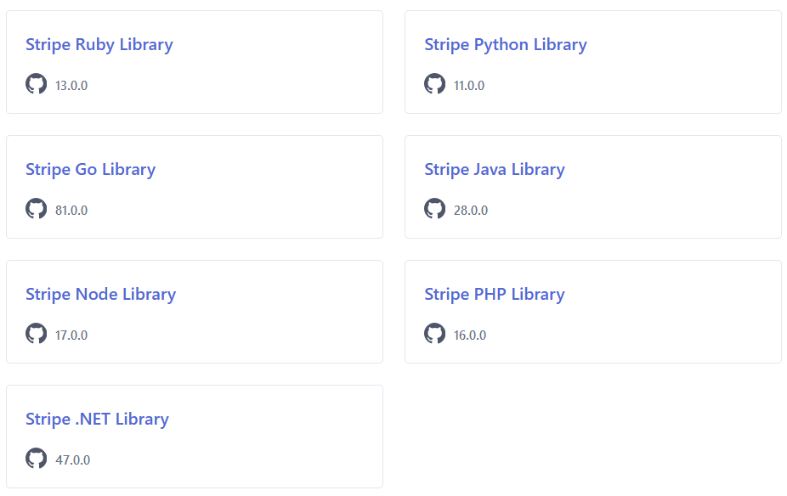
Why choose Stripe?

Slide 11
Comparing key features & pricing

Slide 12
Pricing & Comparing
Feature/Provider | Stripe | Square | PayPal
Transaction Fees | 2.9% + $0.30/ Transaction | 2.9% + $0.30/ Online transaction 2.6% + $0.10 / Swipe | 2.9% + $0.30/ Transaction
Monthly Fees | None | None | None
Supported Payments | Credit/Debit cards, Bank Cards, ACH, Digital Wallets, etc. | Credit/Debit cards, Digital Wallets, Cash App, Hardware, etc. | Credit/Debit cards, PayPal Credit, ACH, Digital Wallets, QR Codes, etc.
Currencies | 135+ | 8+ | 100+
International Use | Yes | Limited | Yes (Some fee for cross-border transaction)
Integration | APIs, SDKs, and extensive plugins for various programming languages and platforms | User-friendly interface, POS integration | APIs, extensive plugins for websites and e-commerce platforms
Customizability | High | Limited | High
Payout Speed | 2-days standard | 1-2 days | 1-2 days
Unique Features | Extensive global reach, support for recurring billing, seamless subscription management | POS system included, hardware available | Easy PayPal-to-PayPal transfers, PayPal Credit

Slide 13
Demo

Slide 14




Summary
Complete toolkit
Stripe build the most powerful and flexible tools for ecommerce
Developer first
Stripe ship more quickly with powerful and easy-to-use APIs
Always improving
Stripe is continuously improving, optimizing, and enhancing its platform to deliver a better experience
Global scale
Stripe help power millions of businesses in 100+ countries and across nearly every industry

Slide 15

References
Stripe Documents: https://docs.stripe.com
Stripe History: https://en.wikipedia.org/wiki/Stripe,_Inc.

Slide 16
Q & A

Slide 17

THANK YOU!

